Slide 1
Intro to Meditation and Mindfulness
- About 30-45 minutes+ Thanksgiving Event

Slide 2
Icebreaker Game- Fastest Animal

Slide 3
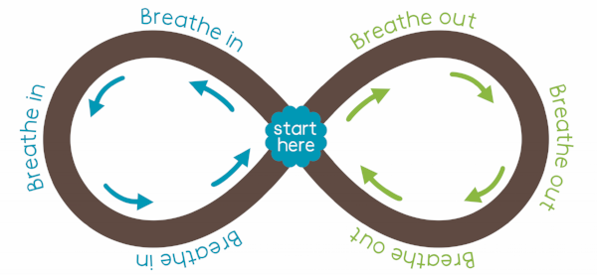
Metronome Breathing Activity
https://www.youtube.com/watch?v=gTw5BV6R4uw&ab_channel=orgforlearning
3 minutes

Slide 4
Motivation & Benefits
Motivation
Give yourself short term and long-term benefits
Habit of doing it every other day/everyday
A cue that reminds you of your calm nature
Benefits:
A technique to serve for long time(different from others)
Short term relief of pain(release of endorphins and serotonin)
Productivity/ Better academic success

Slide 5
Meditation vs Mindfulness
What is Meditation
Sitting down/Guided
Usually to calm ourselves down
Focus on the present
Timed practice
Everything is about awareness
What is Mindfulness?
The ability to have one pointed focus on a particular sensory stimuli
Throughout the day, all the time(Mindfulness helps meditate)
Voluntary effort of awareness of the task

Slide 6
Problems to encounter
Nature of Mind/Brain
Go towards future and past
Go towards negatives(Cognitive Reactivity)
Escape Boredom(seek stimulation)
Unable to be patient with yourself
Fight/Flight response

Slide 7
Meditation Technique: Breathing
Before you begin if you need to regulate your breath to be more uniform try taking longer breaths and letting them out more slowly
Have a one syllable word for inhalation and exhalation
“In” and “Out”
“1” and “2”
“Let” and “Go”
Make your own
Using the syllable as a sword
Abdomen rise and fall
When beginning your breathing techniques it can be helpful to focus on positive things when you inhale and imagine you are exhaling negative thoughts and feelings
Main goal is to focus on the breath as a cue

Slide 8
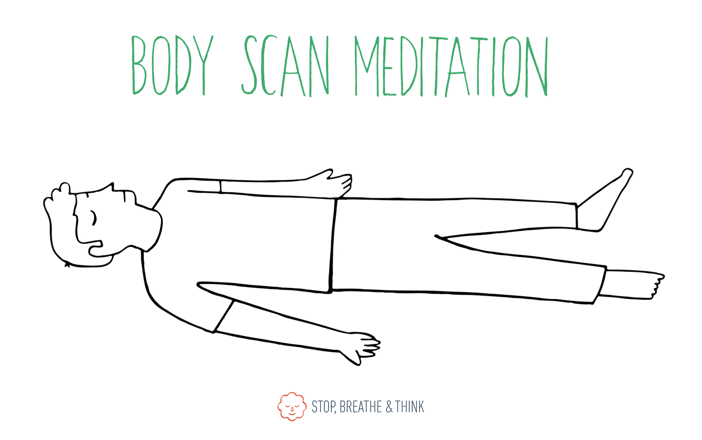
Meditation Technique: Body Scan
Body scan mediation is a good way to release tension you might not even realize you're experiencing.
Benfits:
Improved sleep quality
Anxiety relief
Stress relief
Greater self-awareness
Boosts self-compassion
How to in 4 easy steps:
1. Stop. Remember - sit up tall, keep your back straight, and find a posture that is both energized and relaxed. Alternatively, you can lay down for this mediation.
2. Breathe. Take 10 deep breaths to relax.
3. Think. Focus on the sensations in your body in the following order: head, face, neck, shoulders, upper back, lower back, abdomen, pelvis, upper legs, lower legs, and feet.
4. Repeat in reverse.

Slide 9
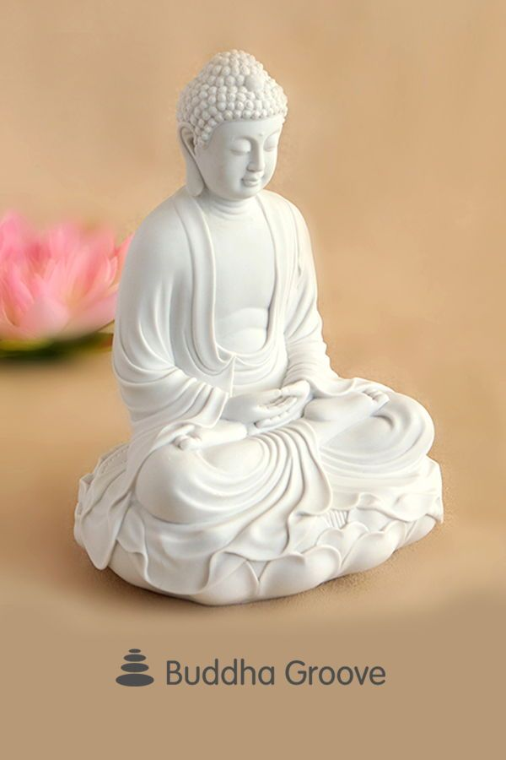
Moving forward and improving
Those two techniques will get you a long way from where you are right now.
Cumulative experience will improve focus and awareness
Have a mindset of letting go
During meditation, tell yourself I am giving only 5 minutes of my day to improve my mental health
Create your own mantra- an inspiration quote
Mine is “ Whatever arises in the mind will also cease, so why hold?”

Slide 10
Mindfulness
Talked a lot about Meditation
Mindfulness is your passive practice of meditation
Reduce unnecessary stimulations (your life events directly impact your mental state during meditation)
Being in the zone for all activities: voluntary effort- default mode vs active mode
Sports
Tests
Mindfulness and mental health

Slide 11
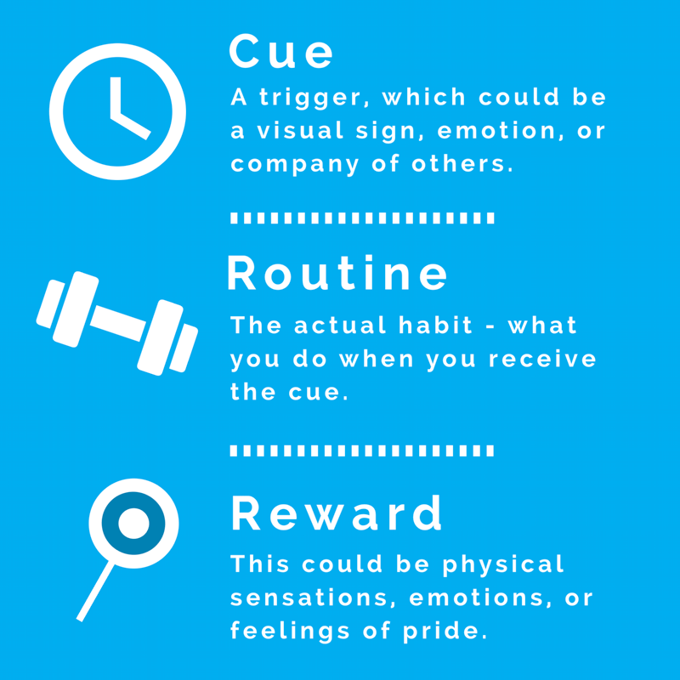
Habit building
Some mental habits to build
Nonjudgement(during meditation/ outside)
Open Mindedness
Lowering ego/ selflessness
Lowering unnecessary stimulations
Finding balance between academics and personal development
Inner passion to discover your self and your true nature

Slide 12
Summary
Mindfulness in real world improves meditation
Motivation and benefits are important for improving meditation(building habits)
Fight/Flight response can be manipulated by awareness of breath
Using a stimuli(visual image/ counting/ one syllable word) can help with attention- rehearsal is key

Slide 13
Thanksgiving Meditation
https://youtu.be/QkJYzuyPtUQ
One thing you are grateful for

